Slide 1


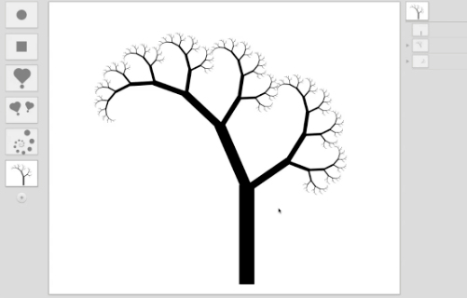
Recursive drawing
The Beauty and Joy of Computing Lecture #11 Recursion II
UC Berkeley EECS Lecturer Gerald Friedland
Toby Shachman created this amazing spatial programming language called “Recursive Drawing” that allows you to create drawings (even recursive ones) without typing a line of code. It’s a great example of a next-generation interface…
recursivedrawing.com

Slide 2
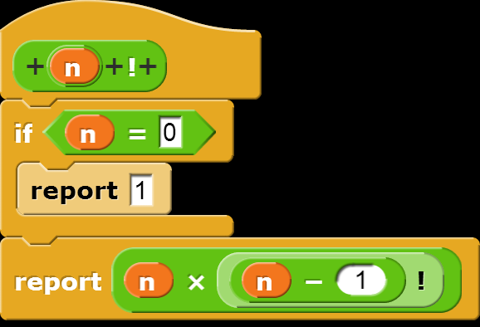
How the Computer Works … n!
Factorial(n) = n! Inductive definition:
n! = 1 , n = 0
n! = n * (n-1)!, n > 0
Let’s act it out…
“contractor” model
5!
n | n!
0 | 1
1 | 1
2 | 2
3 | 6
4 | 24
5 | 120

Slide 3
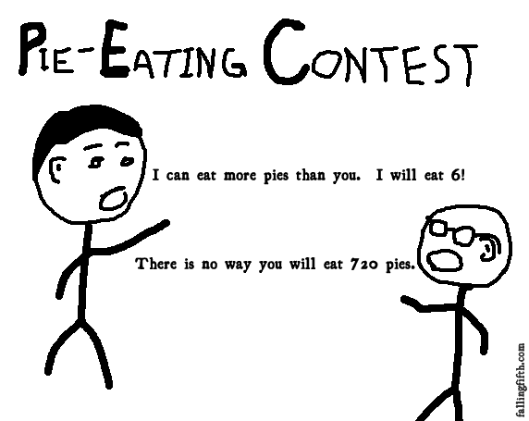
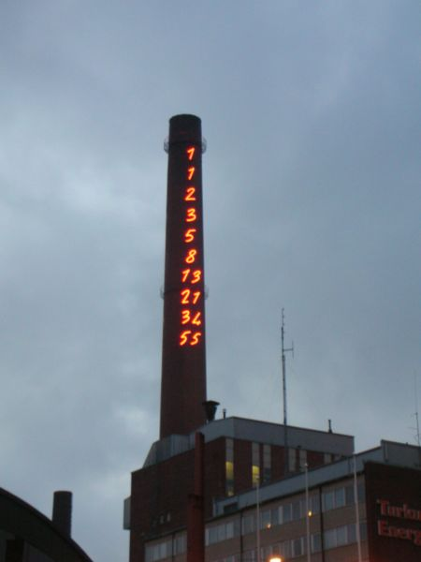
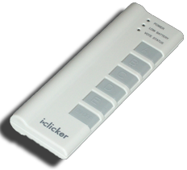
Order of growth of # of calls of n!
Constant
Logarithmic
Linear
Quadratic
Exponential
(source: FallingFifth.com)

Slide 4

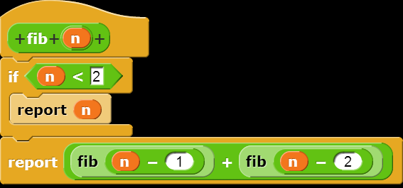
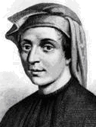
How the Computer Works … fib(n)
en.wikipedia.org/wiki/Fibonacci_number www.ics.uci.edu/~eppstein/161/960109.html
Inductive definition:
fib(n) = n , n < 2
fib(n) = fib(n-1)+fib(n-2), n > 1
Let’s act it out…
“contractor” model
fib(5)
n | fib(n)
0 | 0
1 | 1
2 | 1
3 | 2
4 | 3
5 | 5
Let’s now: trace… (gif from Ybungalobill@wikimedia)
Leonardo de Pisa aka, Fibonacci

Slide 5
Order of growth of # of calls of fib(n)
Constant
Logarithmic
Linear
Quadratic
Exponential
Chimney of Turku Energia, Turku, Finland featuring Fibonacci sequence in 2m high neon lights. By Italian artist Mario Merz for an environmental art project. (Wikipedia)

Slide 6
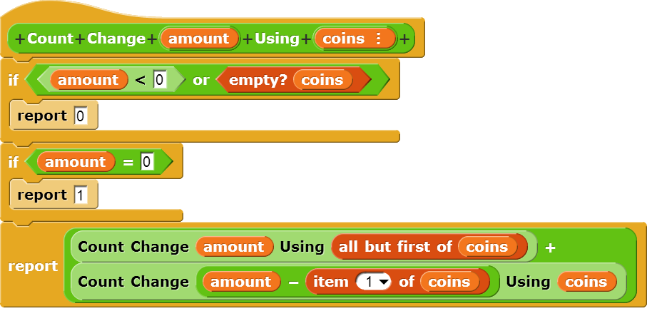
Counting Change (thanks to BH)
Given coins {50, 25, 10, 5, 1} how many ways are there of making change?
5
2 (N, 5P)
10
4 (D, 2N, N5P, 10P)
15
6 (DN, D5P, 3N, 2N5P, 1N10P, 15P)
100?

Slide 7
Call Tree for “Count Change 10 (10 5 1)”
⬅ Skip Coin
Use Coin ➔
10 (10 5 1)
10 (5 1)
10 (1)
5 (5 1)
0 (10 5 1)
10 ()
9 (1)
0
8 (1)
9 ()
0
8 ()
7 (1)
0
5 (1)
0 (5 1)
1
7 ()
0
6 (1)
6 ()
0
5 (1)
5 ()
0
4 (1)
4 ()
0
3 (1)
3 ()
0
2 (1)
2 ()
0
1 (1)
1 ()
0
0 (1)
1
1
5 ()
0
4 (1)
4 ()
0
3 (1)
3 ()
0
2 (1)
2 ()
0
1 (1)
1 ()
0
0 (1)
1
D?
N?
D
P?
N?
P?
P?
NN
P?
P?
P?
P?
P?
P?
P?
P?
P?
N 5P
P?
P?
P?
10P

Slide 8
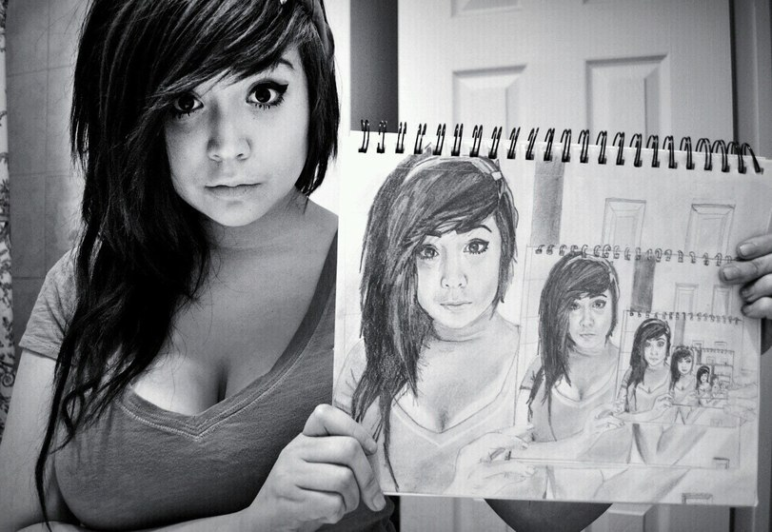
“I understood Count Change”
Strongly disagree
Disagree
Neutral
Agree
Strongly agree
img4.joyreactor.com/pics/post/drawing-recursion-girl-275624.jpeg

Slide 9
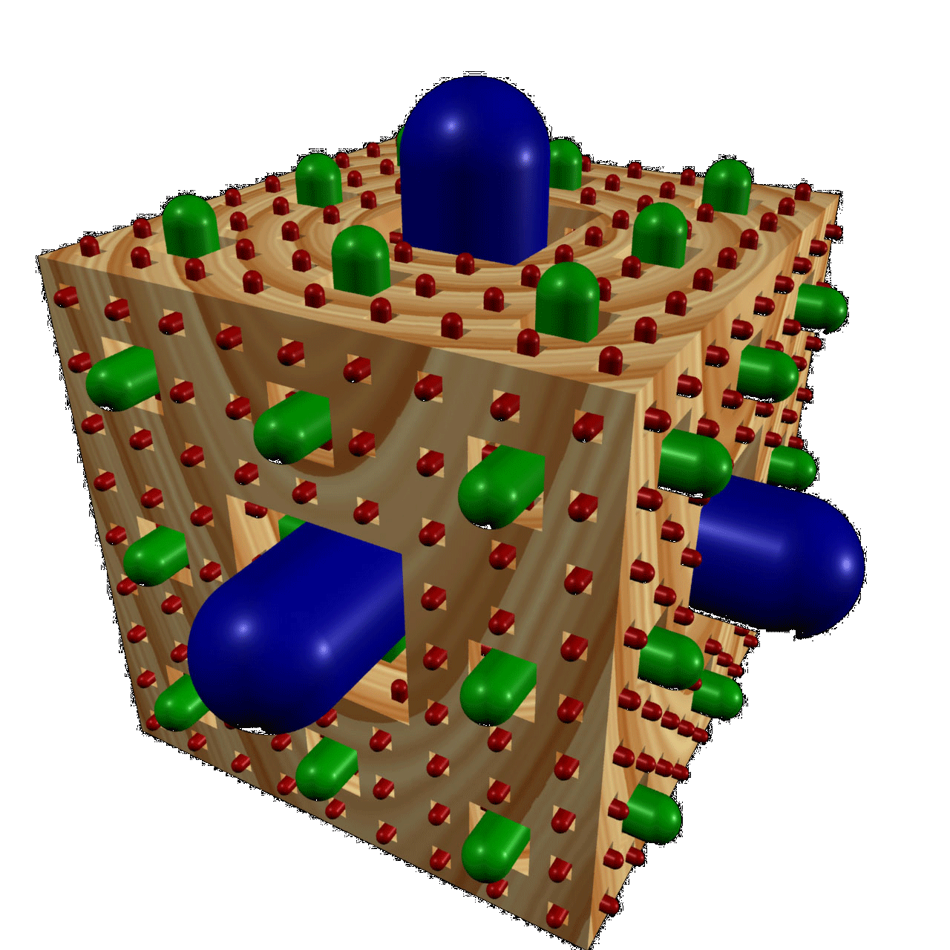
Summary
It’s important to understand the machine model
It’s often the cleanest, simplest way to solve many problems
Esp those recursive in nature!
Recursion is a very powerful idea, often separates good from great (you’re great!)
Menger Cube by Dan Garcia

